Slide 1
ELECTRICAL SCIENCE-1 (15B11EC111) UNIT-2 Lecture-1

Slide 2
Topics to be Discussed
Star-delta transformation
Practice Problems
References

Slide 3
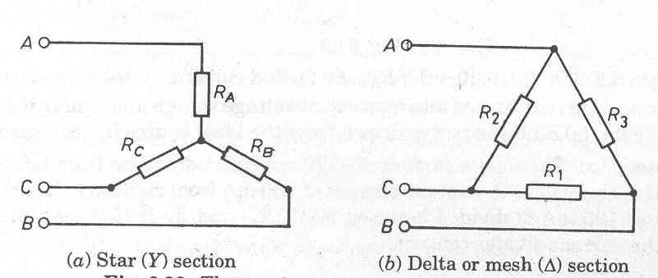
Star-Delta Transformation
3
Notes:
3

Slide 4
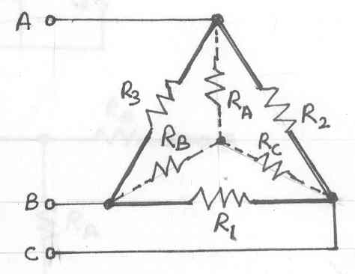
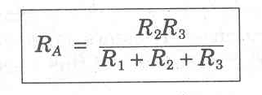
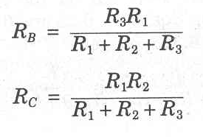
Delta to Star
4

Slide 5
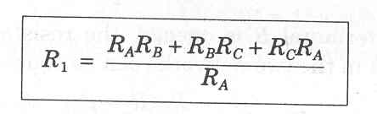
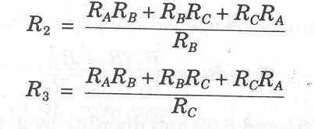
Star to Delta
5

Slide 6
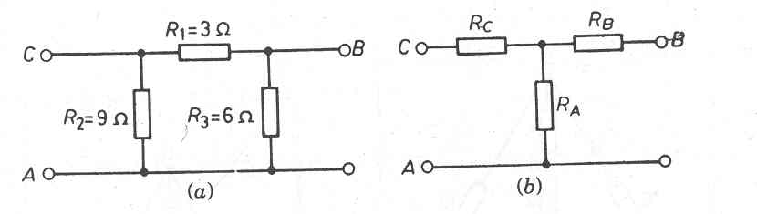
Problem
A π-section of resistors is given in figure. Convert this π-section into an equivalent T-section.
6

Slide 7
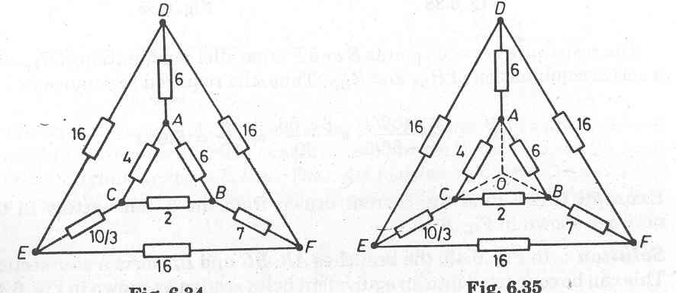
Problem
The figure shows a network. The number on each branch represents the value of resistance in ohms. Find the resistance between the points E and F.
7

Slide 8
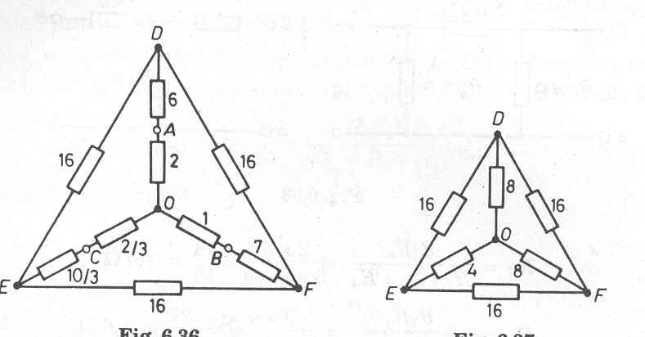
Solution
8

Slide 9
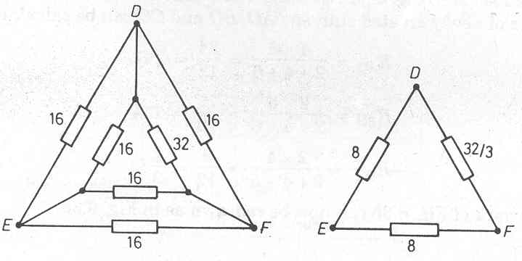
Ans. : 5.6 Ω
9

Slide 10
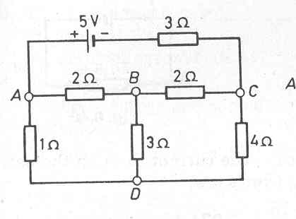
Problem
Find the current drawn from the 5 volt battery in the network shown in figure.
10

Slide 11
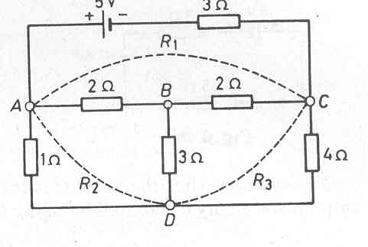
Solution :
11

Slide 12
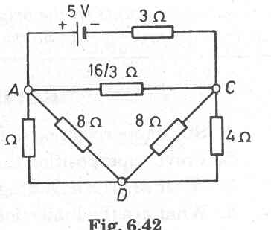
12

Slide 13
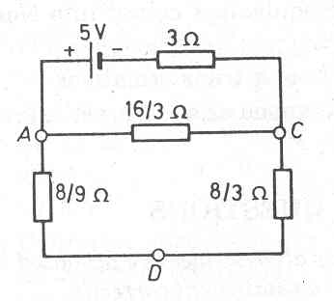
13

Slide 14
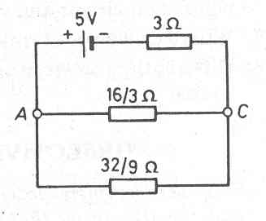
14

Slide 15
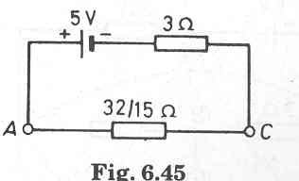
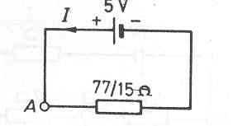
Ans. : 0.974 A
15

Slide 16
REFERENCES
[1] R.C. Dorf and James A. Svoboda, “Introduction to Electric Circuits”, 9th ed, John Wiley & Sons, 2013.

